Slide 1
What makes Chocolate so addictive and likable?
By Coders Nexus:
Omkar Shitole
Shivani Chavan
Sandeep Unnikrishnan
Tom Alex

Slide 2
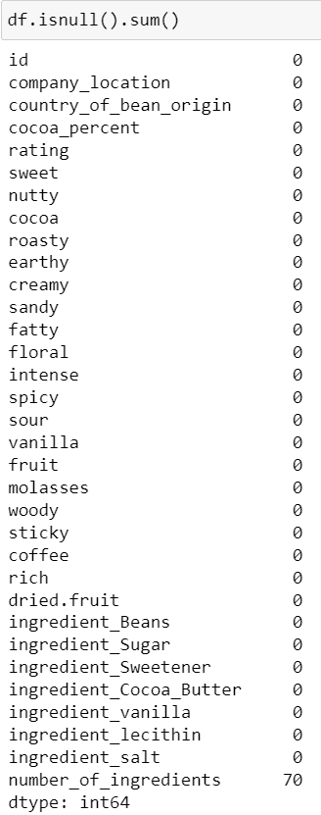
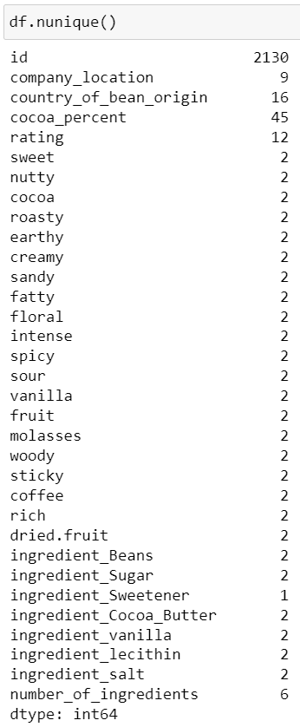
Data Concerns
So our group had three data concerns regarding the data set.
We could observe that there were around 70 null values in the column number_of_ingredients so we had to do some Data Imputation.
We noticed that the distribution type for all the characteristics were skewed towards their absence rather than presence in good chocolate. Furthermore, the dataset characteristics including flavors and ingredients was in a 80/20 ratio.
We also noticed that the column ingredient_Sweetener had only 1 unique value that was ‘Yes’, so this column does not provide any useful insight.

Slide 3
Hypothesis
We tried to determine what are the characteristics including flavor and ingredients that make a chocolate likable or addictive contributing to repeat customers.
As seen below, we tried different algorithms to make a machine learning model that could help us predict the the ratings of a chocolate based on its characteristics provided.
We used the following algorithms for the purpose of comparison in our RMSE score:
Random Forest
Gradient Boosted Tree
Ridge Regression(L2)
Lasso Regression(L1)
5) XGBoost
6) SVM
7) K Nearest Neighbors(grid)
8) SGD

Slide 4
Data Preprocessing / Cleaning
We replaced all the null values (“N/A”) from the column “number_of_ingredients” with 0 , as we noticed that the dataset did not count the ingredient_Sweetener as part of the count so it was no issue doing so.
We also decided to drop the the entire column of ingredient_Sweetener as it did not provide any useful insights and had all the values as ‘Yes’.
For the purpose of generating a correlation heat map ONLY, we replaced all “No” values in the rows with 0 and all “Yes” values in the rows with 1.

Slide 5
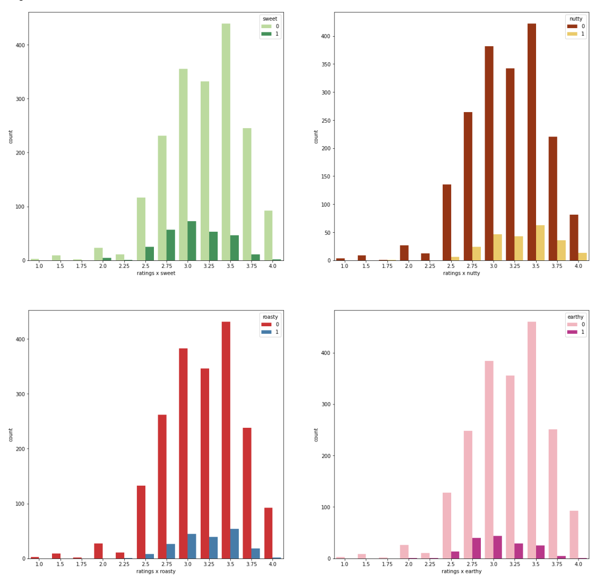
Data Exploration
Consumers prefer nutty chocolates
Consumers enjoy roasted chocolates as well
Consumers want their chocolate to be sweet
Consumers don't prefer earthy chocolates as much

Slide 6
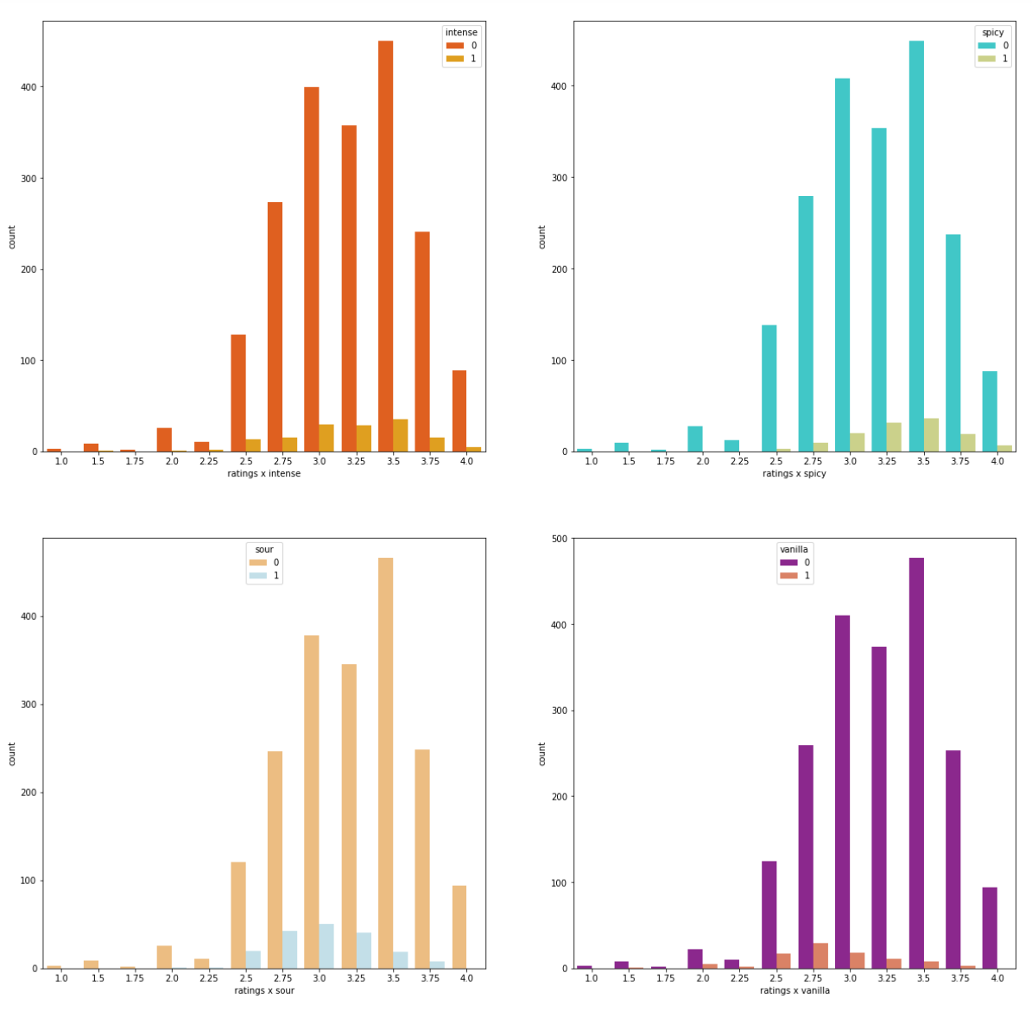
Data Exploration
Consumers enjoy intense chocolates.
Consumers also like some spice to their chocolates
Consumers don't enjoy sour chocolates as much
Consumers don't enjoy vanilla in their chocolate

Slide 7
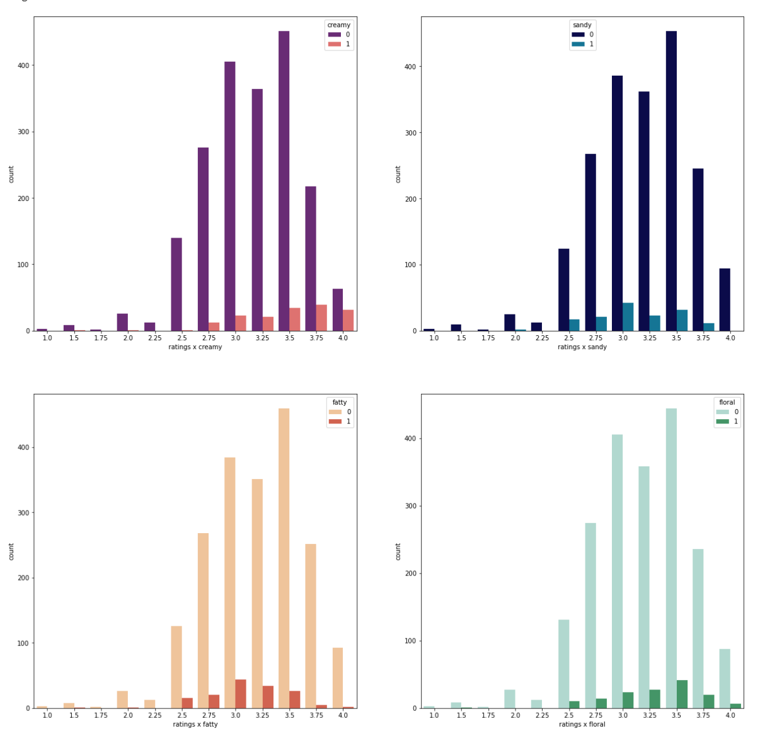
Data Exploration
Consumers enjoy creamy chocolates
Consumers don't enjoy sandy feel in their chocolates
Consumers don't enjoy fatty chocolates
Consumers somewhat enjoy floral characteristics in their chocolate

Slide 8
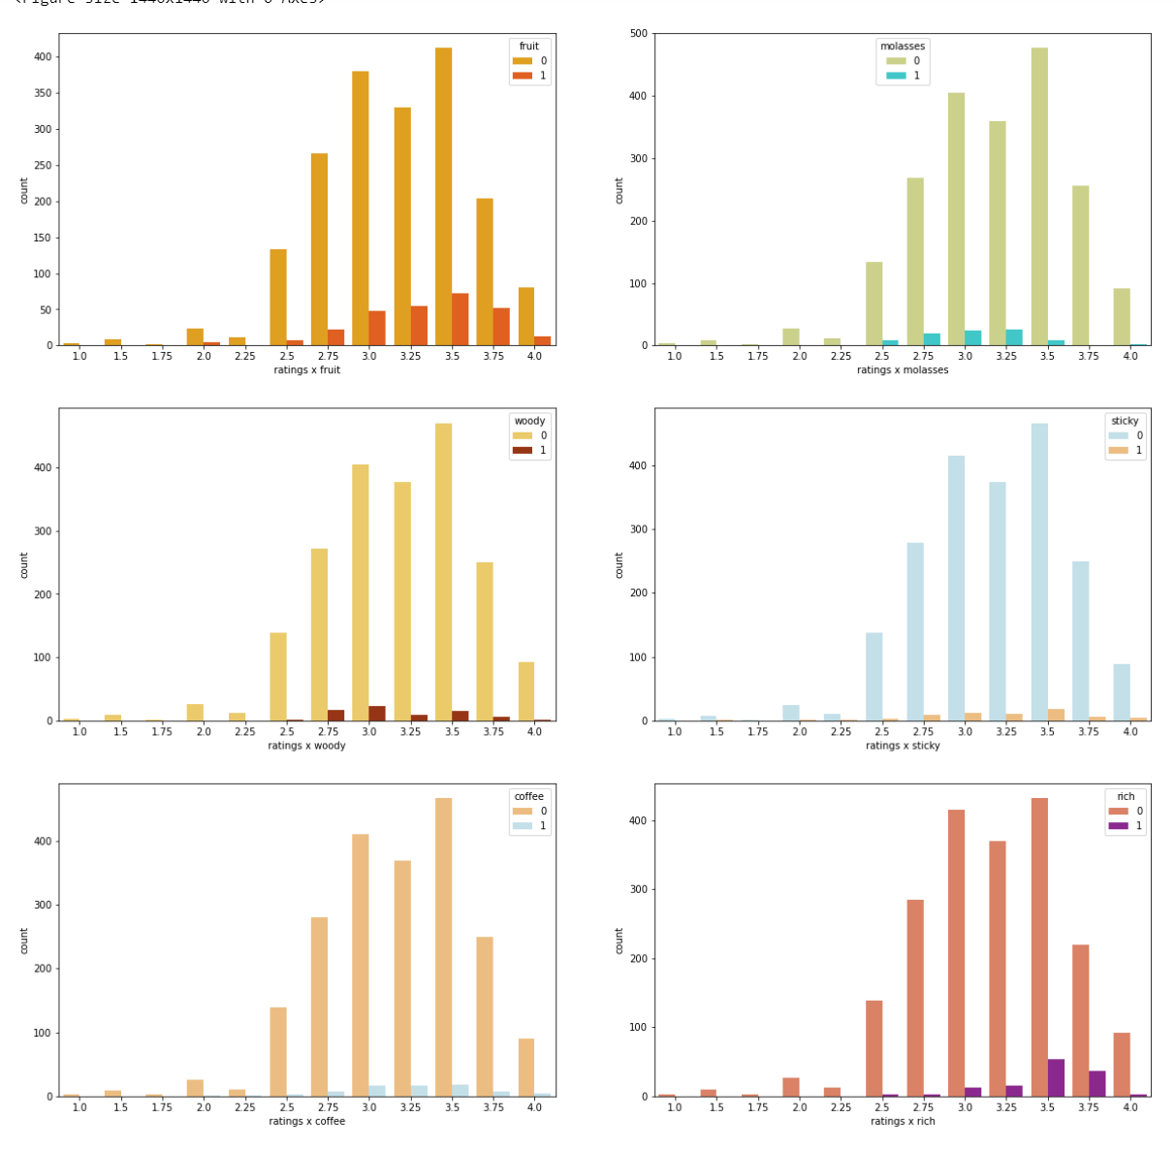
Data Exploration
We can notice that people enjoy fruits in their chocolates they also prefer richness to their chocolate on the other hand they don't enjoy stickiness, woody flavor , molasses and coffee in their chocolates.

Slide 9
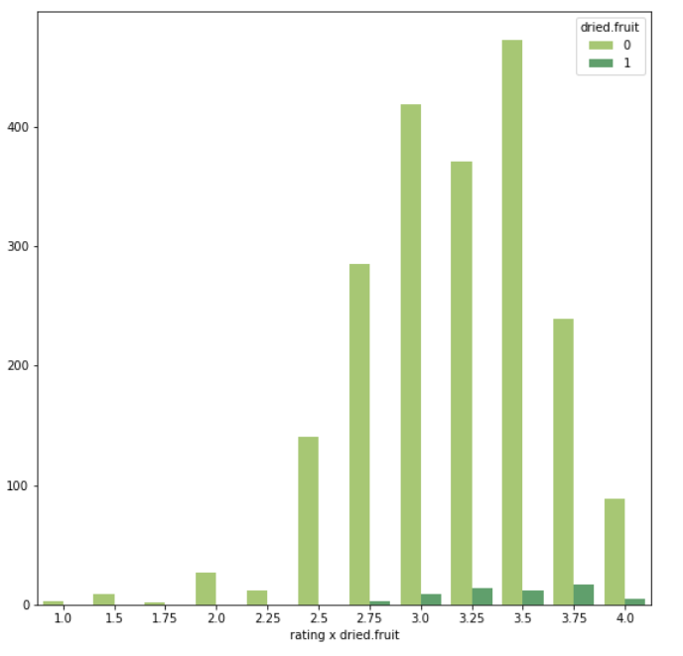
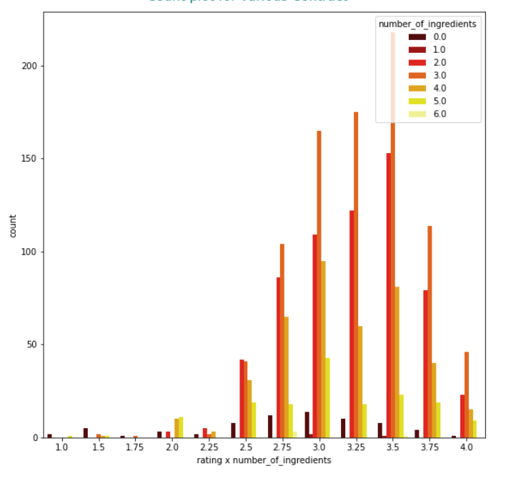
Data Exploration
Consumers seem to enjoy dry fruits in their chocolates.
We can notice that the highest rated chocolates have at most 3 ingredients.

Slide 10
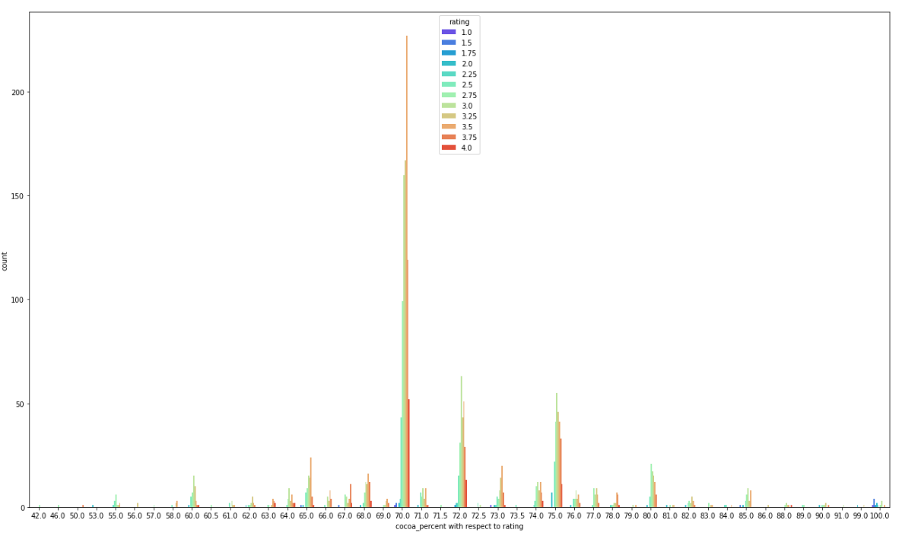
Data Exploration
This shows that the highest distribution of good chocolate ratings (greater than 2.5) contain around 70% cocoa. Furthermore, this suggests that 70% is the optimal level of cacao in highly rated chocolate.

Slide 11
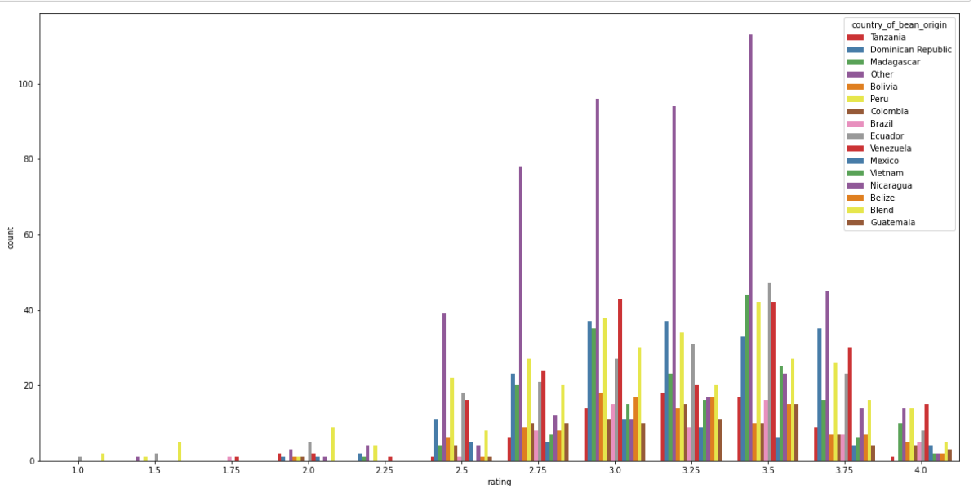
Data Exploration
Chocolate beans from Venezuela have consistently produced higher ratings so we can assume that the quality of beans from Venezuela is higher compared to the rest of the countries.

Slide 12
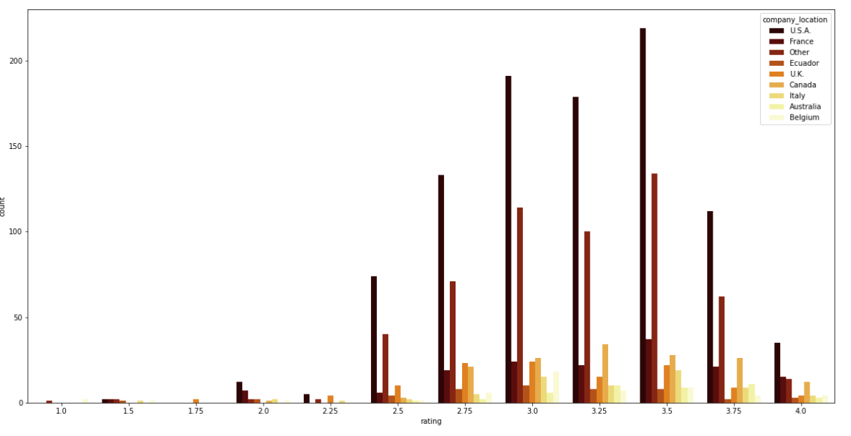
Data Exploration
We can see that most of the highest rated chocolates are produced in the USA followed by other countries.

Slide 13
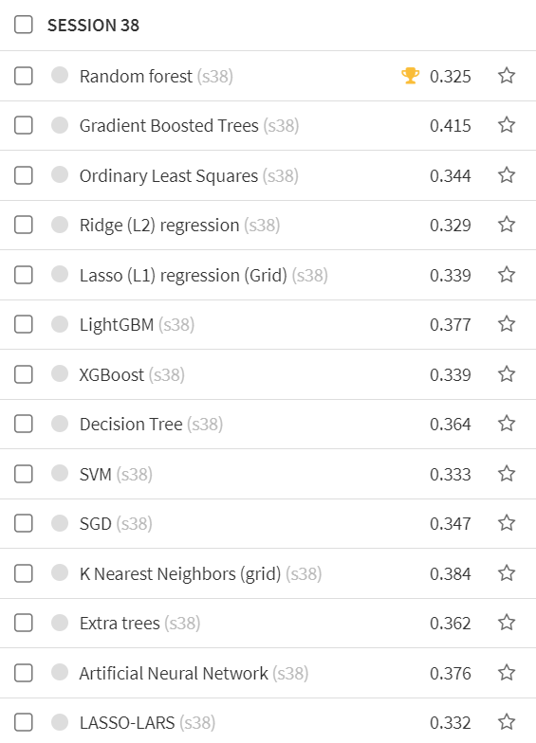
Modeling and Algorithm
We tried different types of models based on algorithms but our main algorithm in mind was random forest as it provides additional randomness while training.
The lowest RMSE score was produced by Random Forest algorithm, so we decided to use that for our predictive model (a score of 0.325) as seen in the capture to the left.

Slide 14
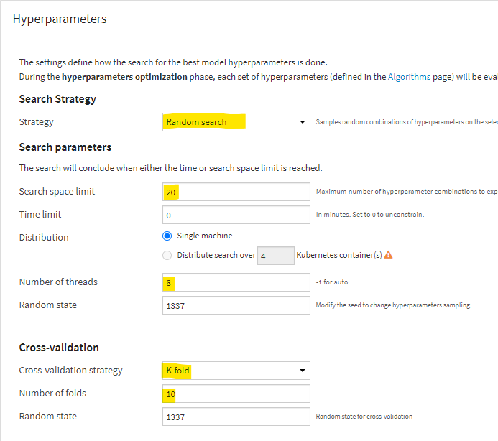
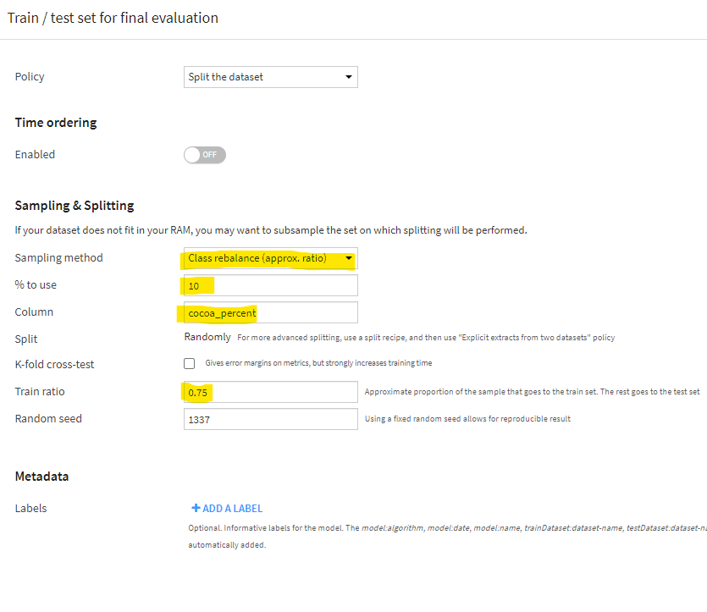
Tuning
We tried to different approaches to get the desired RMSE score so in the end we had to adjust the hyper parametric tuning as well as adjusting our sampling method, seen in the figures (highlighted)

Slide 15
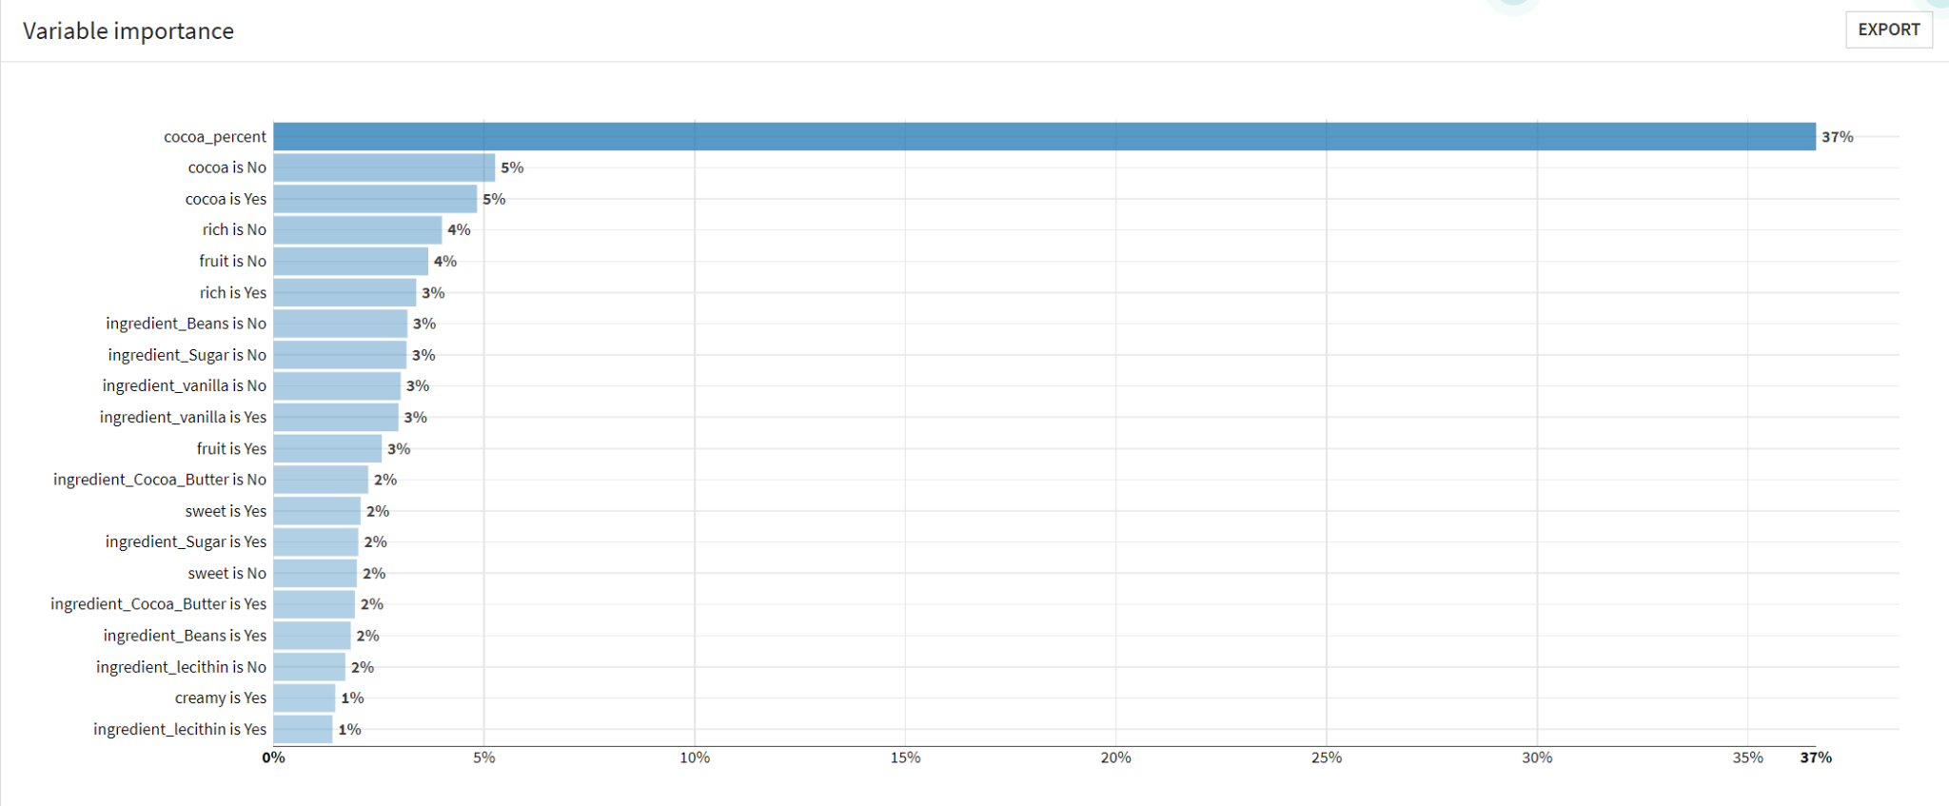
Results

Slide 16
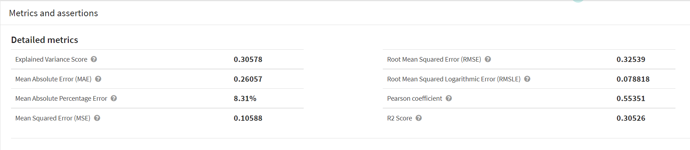
Results

Slide 17
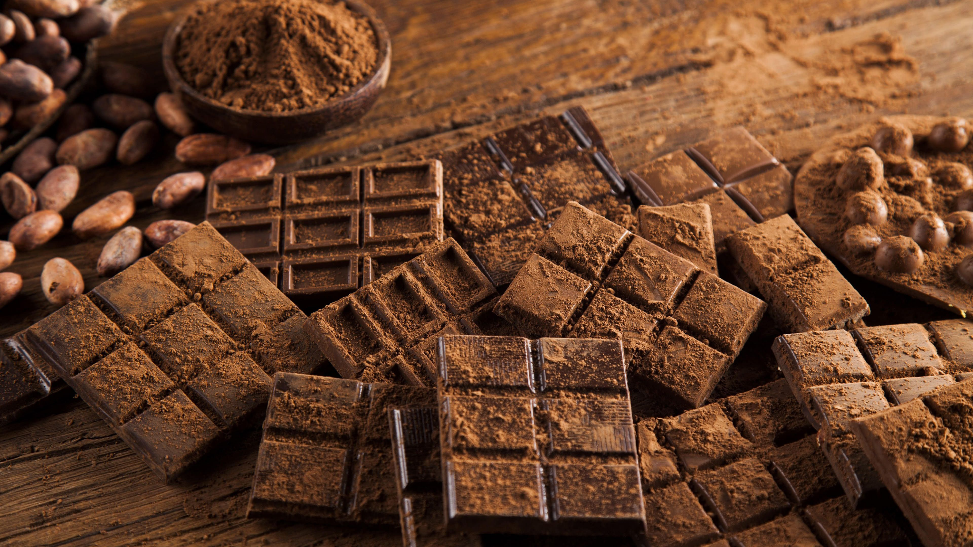
Conclusions
According to the statistics, a chocolate bar should have a minimum of 70% cocoa content, sugar, beans, and cocoa butter as the recommended ingredients.
We also learned that the creamy, cocoa, nutty, rich, and dried fruit nature of a chocolate are crucial elements that contribute to its likeability.
As a result, the corporation can enhance these flavor profiles in the chocolate recipe to raise its rating if it wishes to produce repeat customers.

